Slide 1
The Little Green Web App
A website by:
Jonas M. Olsson, John Harrow and Jack Weir

Slide 2
The Applications of the Website
Information about eco-friendly living, map, recipes and a quiz for fun
To provide information about services in the Dundee area.
Targeted at young people
People that moved recently

Slide 3
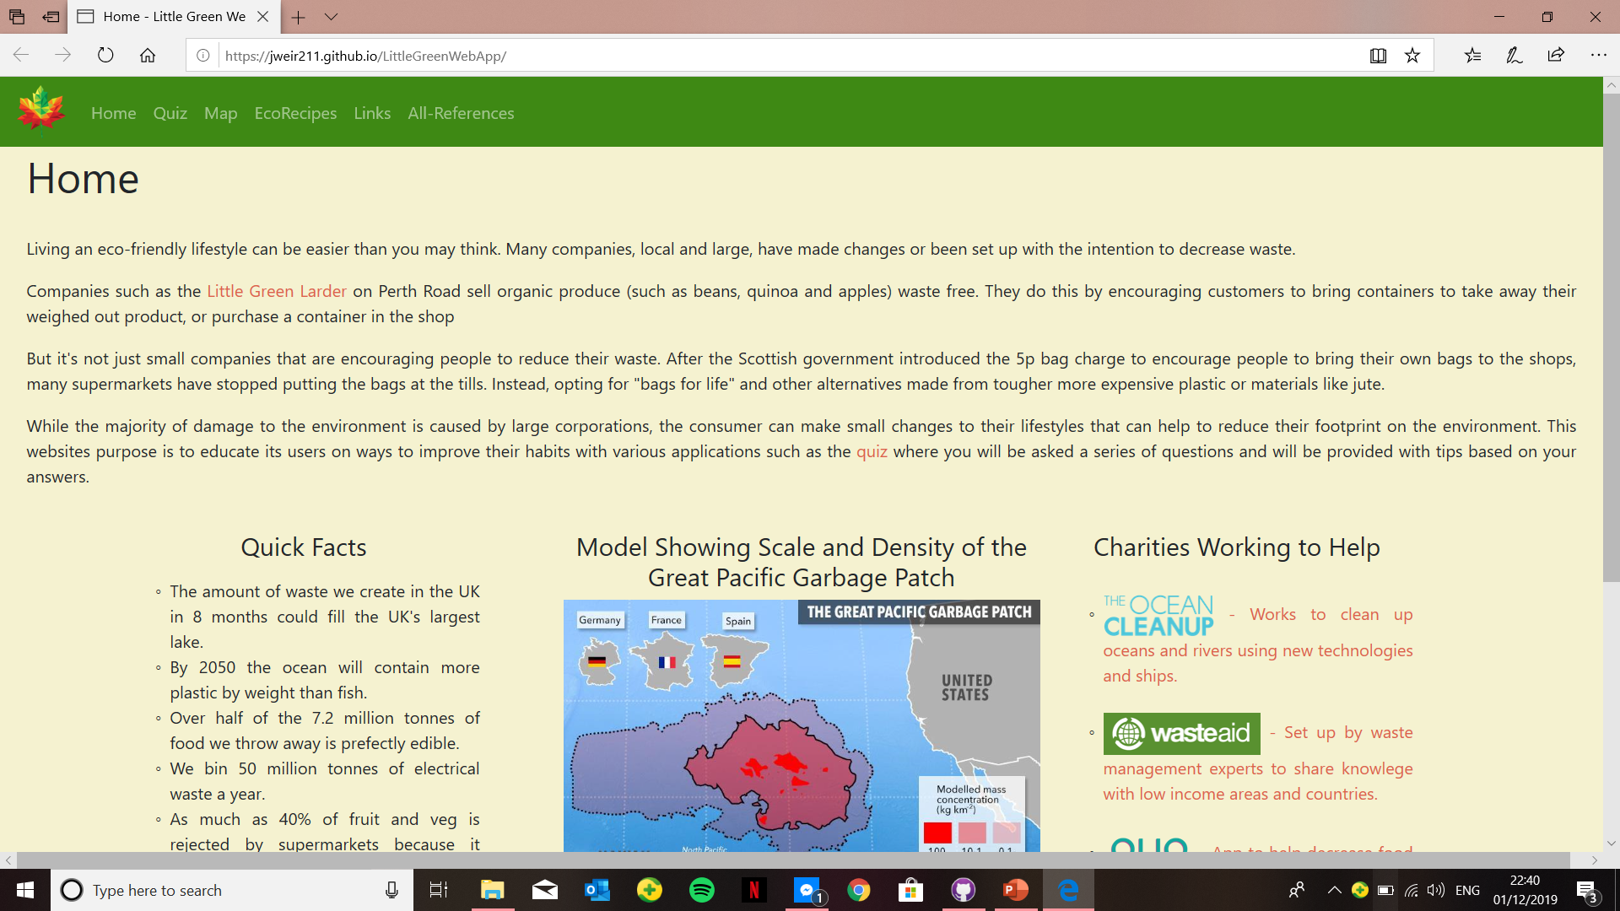
The Home-page
The purpose of our home page is to explain the functions of the site.
It also provides some facts about waste and the environment.
It provides links to websites and charities

Slide 4
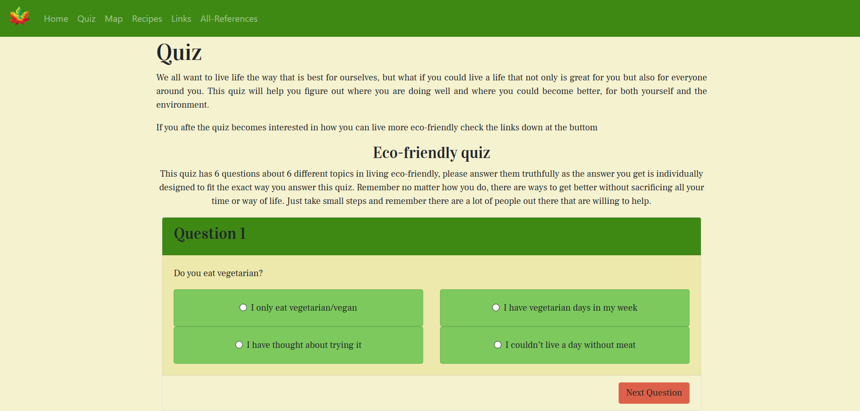
The quiz
The quiz asks 6 questions, from 6 different topics in eco-friendly living
The quiz gives individual responses depending on what you answered in each question
Links to other advice pages

Slide 5
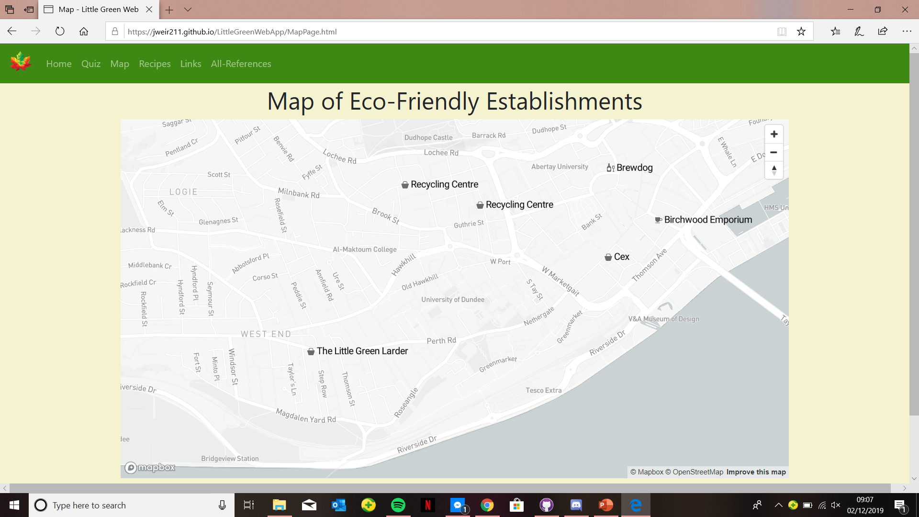
Map
Purpose is to show the user establishments in the Dundee area that provide eco-friendly services.
It also has information on why the establishments are eco-friendly and what services they provide.

Slide 6
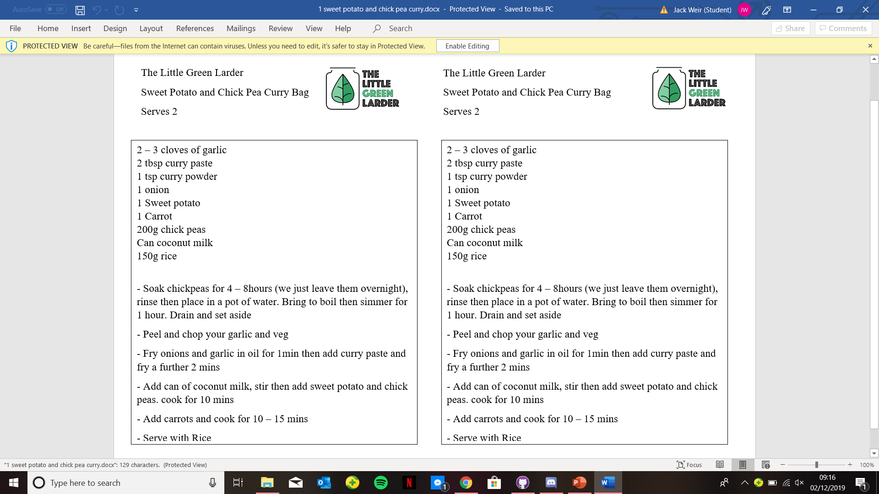
Recipes
We have not yet implemented this part however the idea is that it will be recipes that we have already received from the little green larder on a carousel.
This will provide the user with information on how to use the produce they have purchased from there.

Slide 7
Now a live presentation
“https://jweir211.github.io/LittleGreenWebApp”

Slide 8
Why our application is needed
Mixes fun and information
Nice down on earth website to give advice without judgement

